Slide 1
Statistics for Linguists
(R language)
2023 10 25
Adam J.R. Tallman

Slide 2
Overview
Doing math in R and saving R scripts
Atomic vectors, doubles, integers, characters, logicals, attributes/names, factors
vector, matrix, array
lists, dataframe
saving and loading data

Slide 3
Vector concepts
Atomic vector: a set of single elements
Doubles: A double vector stories regular numbers (can have decimal points)
Integers: Numbers that can be written with no decimal
Character: A piece of text
Logical: TRUE or FALSE

Slide 4
Related concepts
Floating point errors
Indices for positions in a vector
reassignment of values

Slide 5
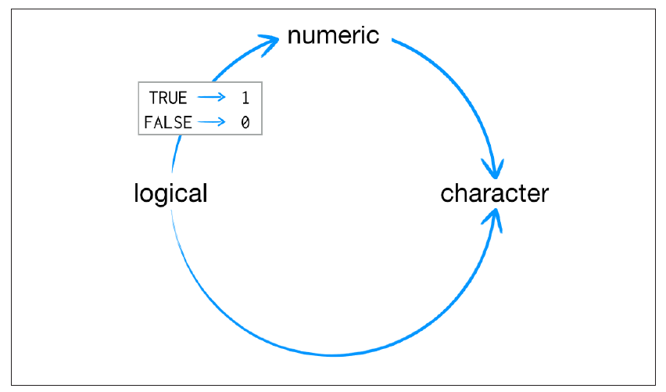
Coercion

Slide 6
More concepts
Matrix: values stored in two dimensional array
Array: a bunch of matrices
Special cases of vectors which are not atomic

Slide 7
Data structures
List: Just a list of elements, but the elements can vectors. One-dimensional (like atomic vectors), but they group together objects rather than individual values.
Dataframe: stacked vectors from left to right. Two-dimensional version of a list.

Slide 8
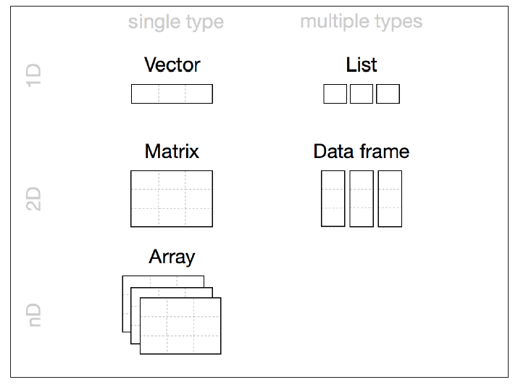
Data structures

Slide 9
Saving and loading data
You can load in data in R.
The most common data storage format is csv (comma separated values) or tsv (tab separated values)
The function read.csv() or read.table() allows you to read a dataframe into R into one of these formats, the function write.csv etc. allows you to save them.
Before we practice one more thing...

Slide 10
Directories
Say you have more than one datasheet and you are going to use both. You might want to call on files from the same directory. You can make it so that you don’t have to spell out the whole directory with
setwd()
Okay, let’s practice.

Slide 11
Exercises
Let’s make a dataframe and load it in
Let’s read a dataframe in https://osf.io/ptq7u

